Slide 1
IMAGE GALLERY
Group Members:
Swanand Pande (43)
Gurpreet Kaur Saimy (52)
Shrey Shah (54)

Slide 2
Problem Definition
Using JAVA as a base language and its multiple features, to simulate an Image Gallery.

Slide 3
Use Case – Basic Functionalities
To display an image.
To display the next image.
To display the previous image.
To display the last image.
To implement slide show of the images.
To display an image at runtime, i.e. to allow user to specify path for displaying images

Slide 4
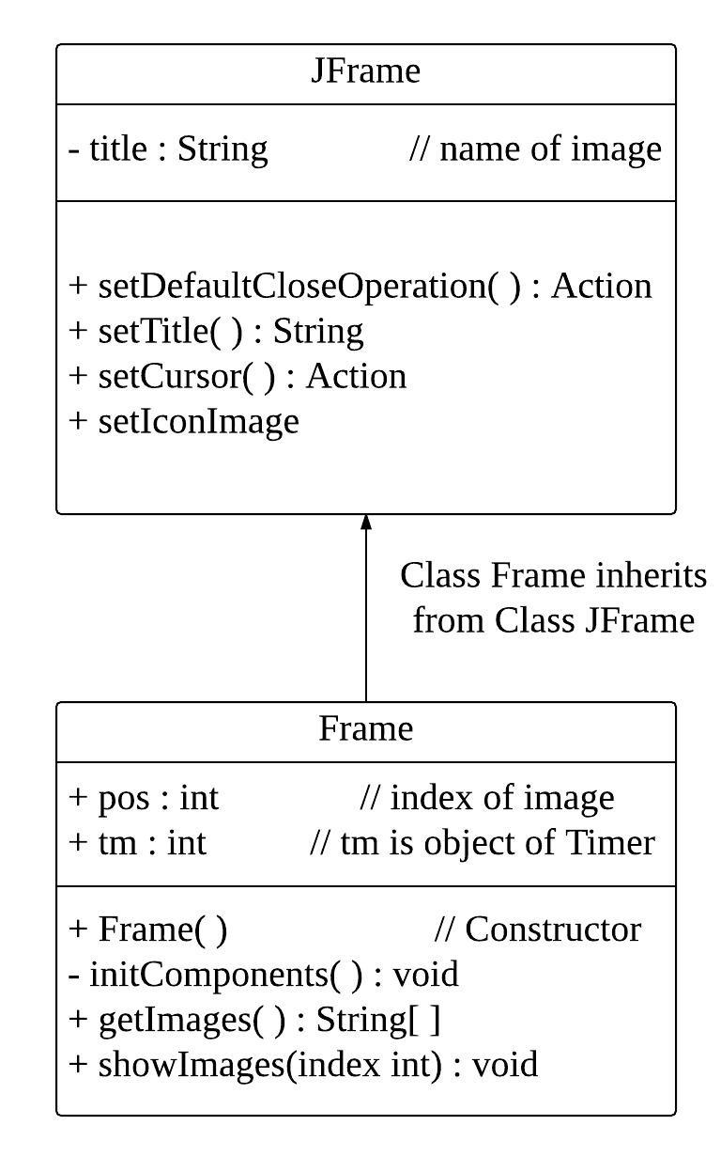
Class Diagram

Slide 5
Implementation of Image Gallery
To create an Image Gallery, certain classes need to be used so that it can be given a realistic effect. Certain features of JAVA which have been used are listed as follows:
Inheritance: It is a process by which an object of class can inherit all the properties of its parent class. It enhances the reusability of code.
Exception Handling: It is a mechanism to handle the runtime errors so that normal flow of the application can be maintained.

Slide 6
Implementation of Image Gallery
Use of Inbuilt JAVA Classes: To implement various functionalities like getting and displaying image we have used Graphics. Also to implement the timing of slideshow we have used Timer class.

Slide 7
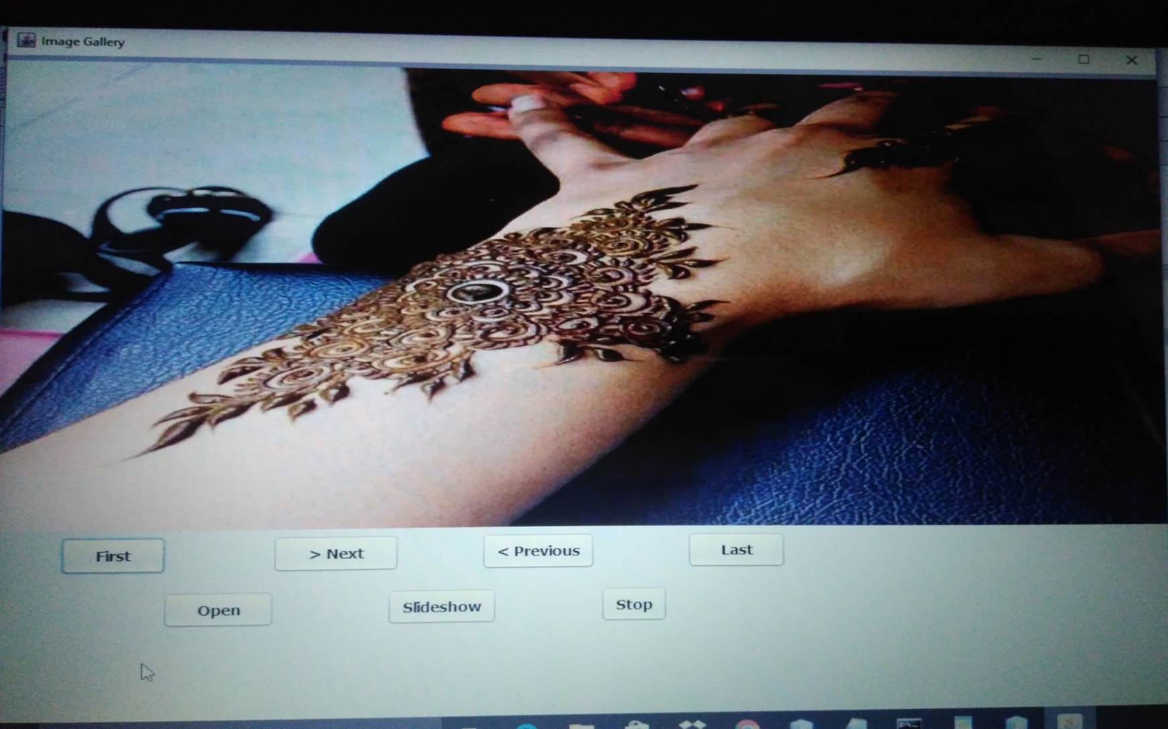
Output Screenshots

Slide 8
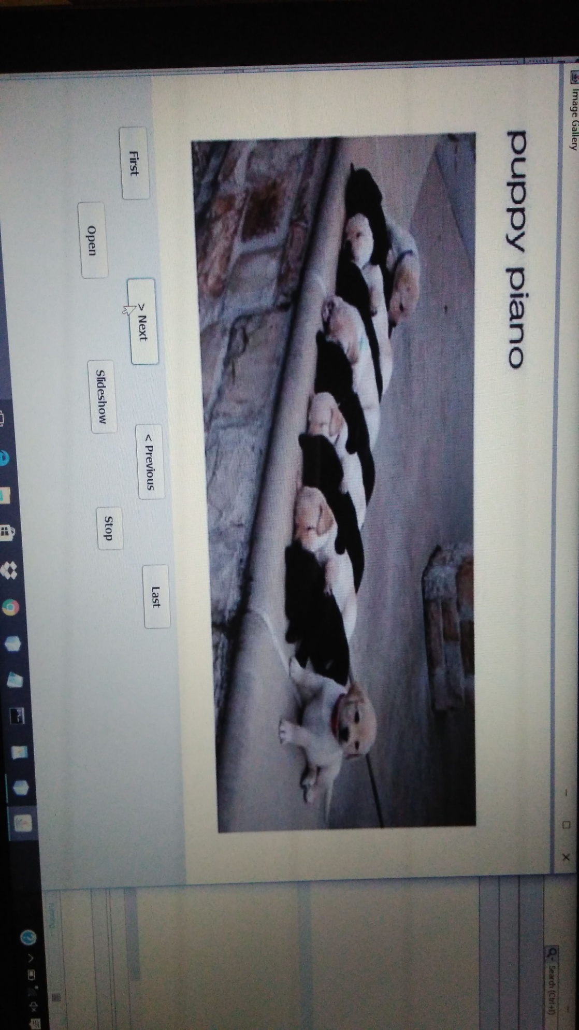
Output Screenshots

Slide 9
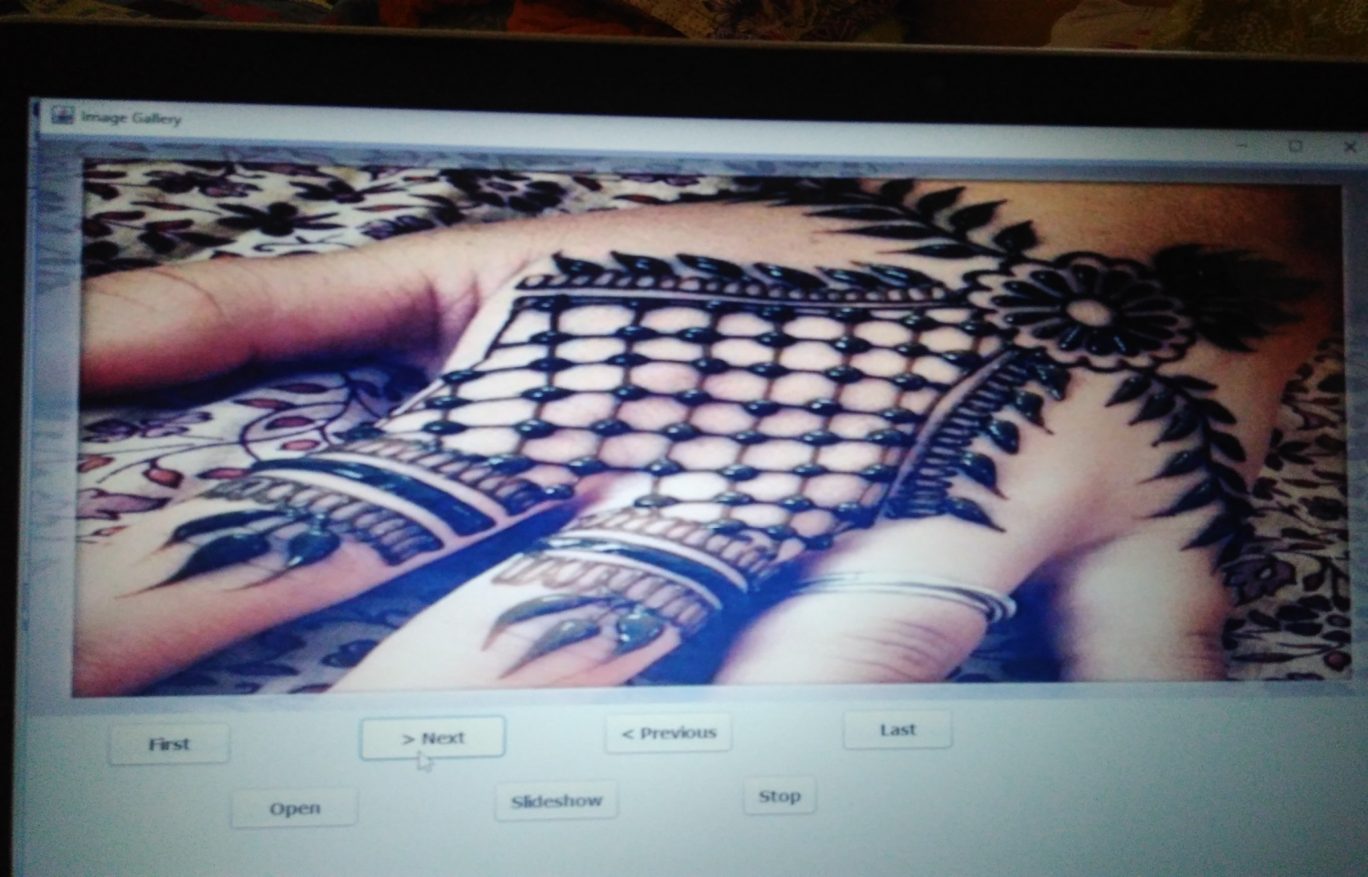
Output Screenshots

Slide 10
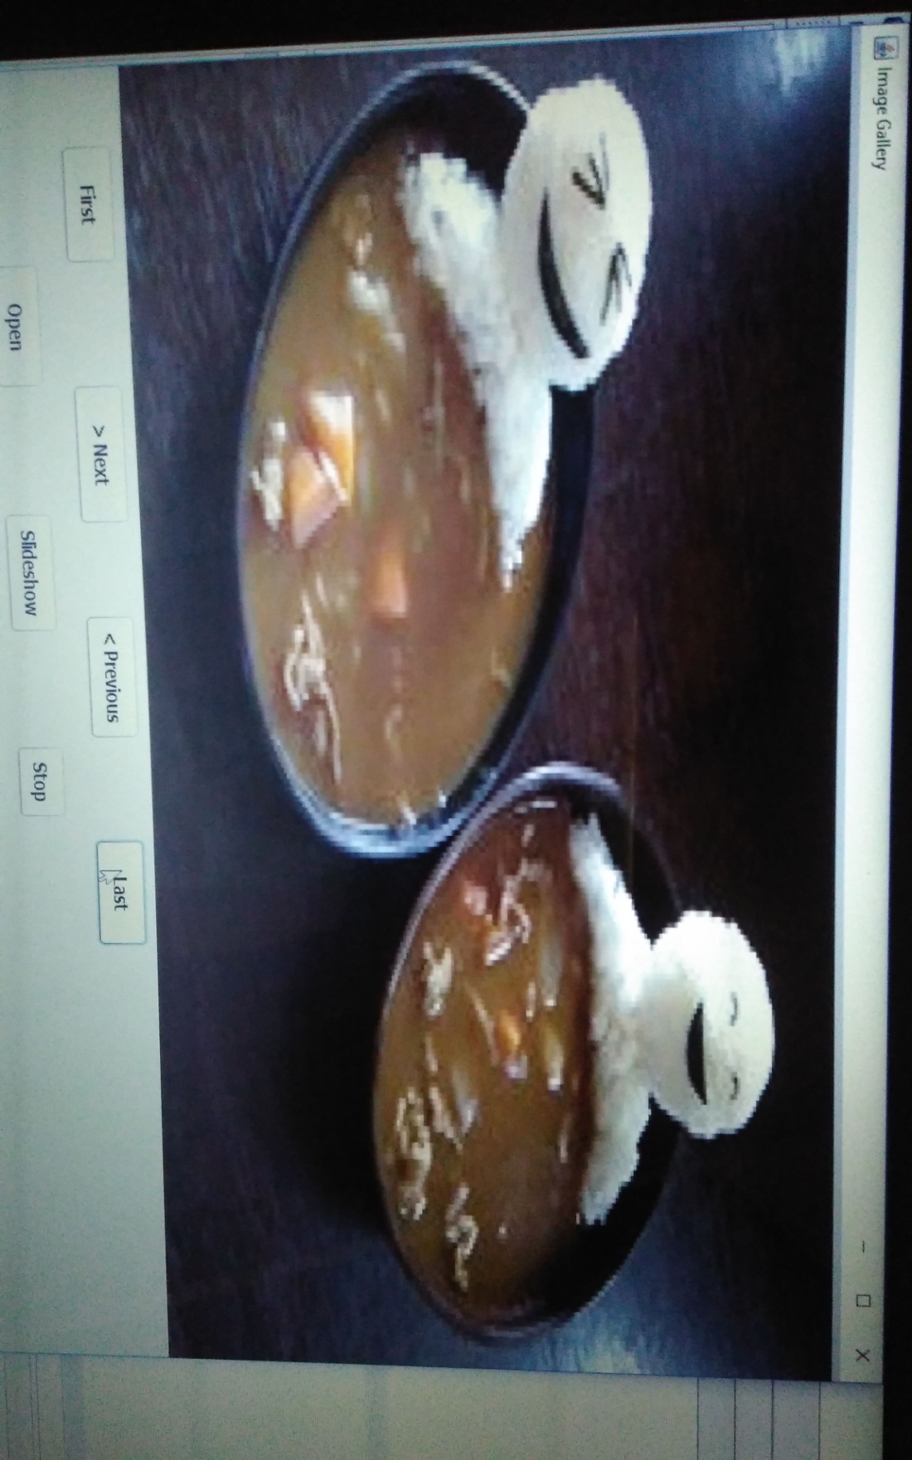
Output Screenshots

Slide 11
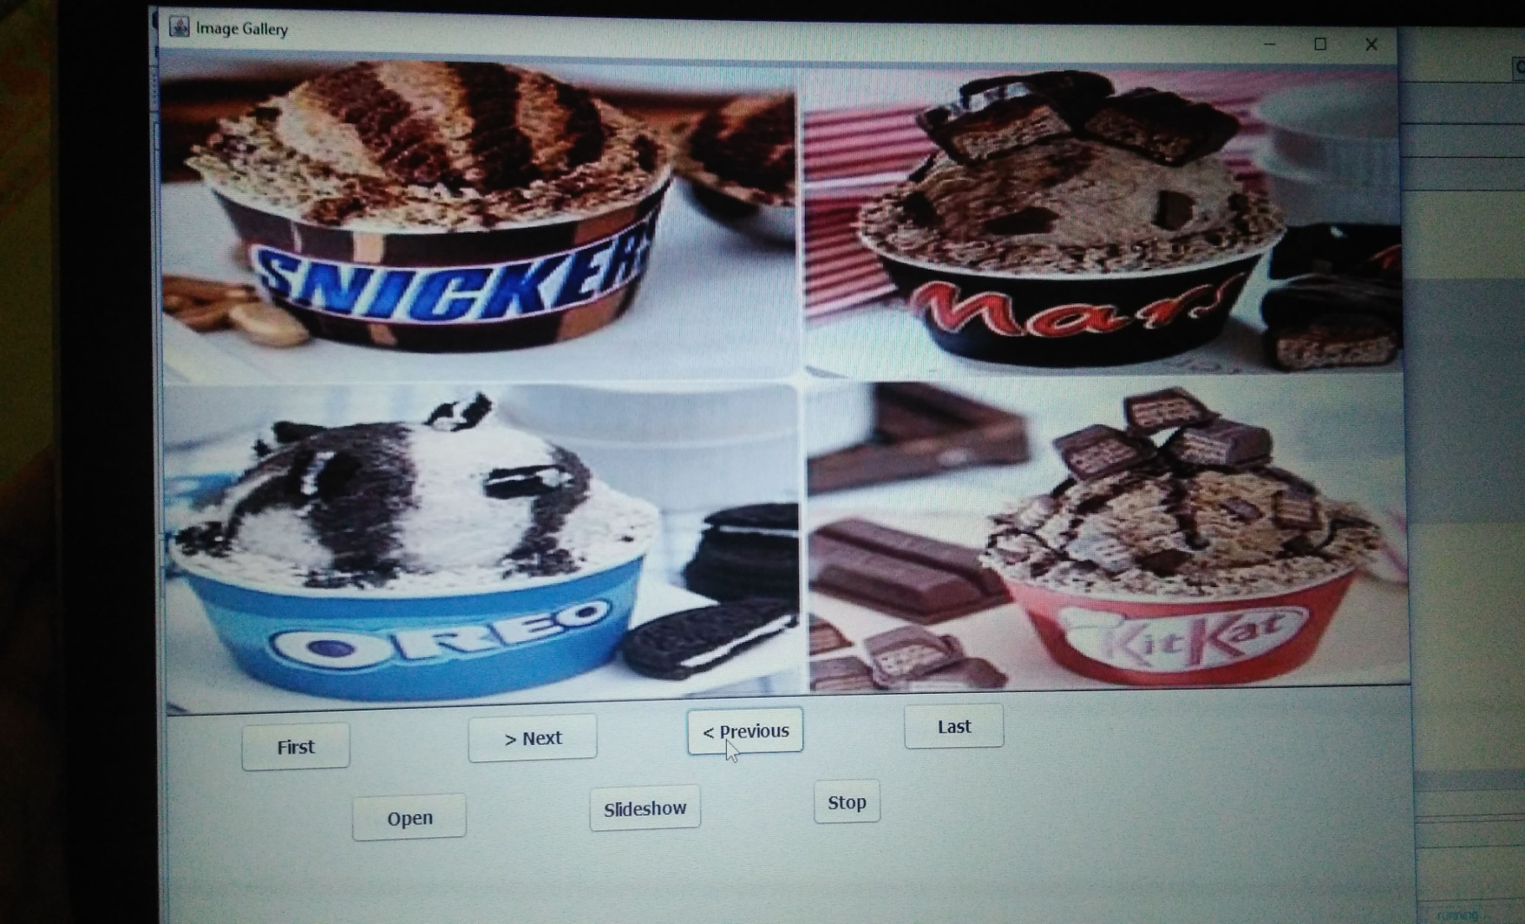
Output Screenshots

Slide 12
Output Screenshots

Slide 13
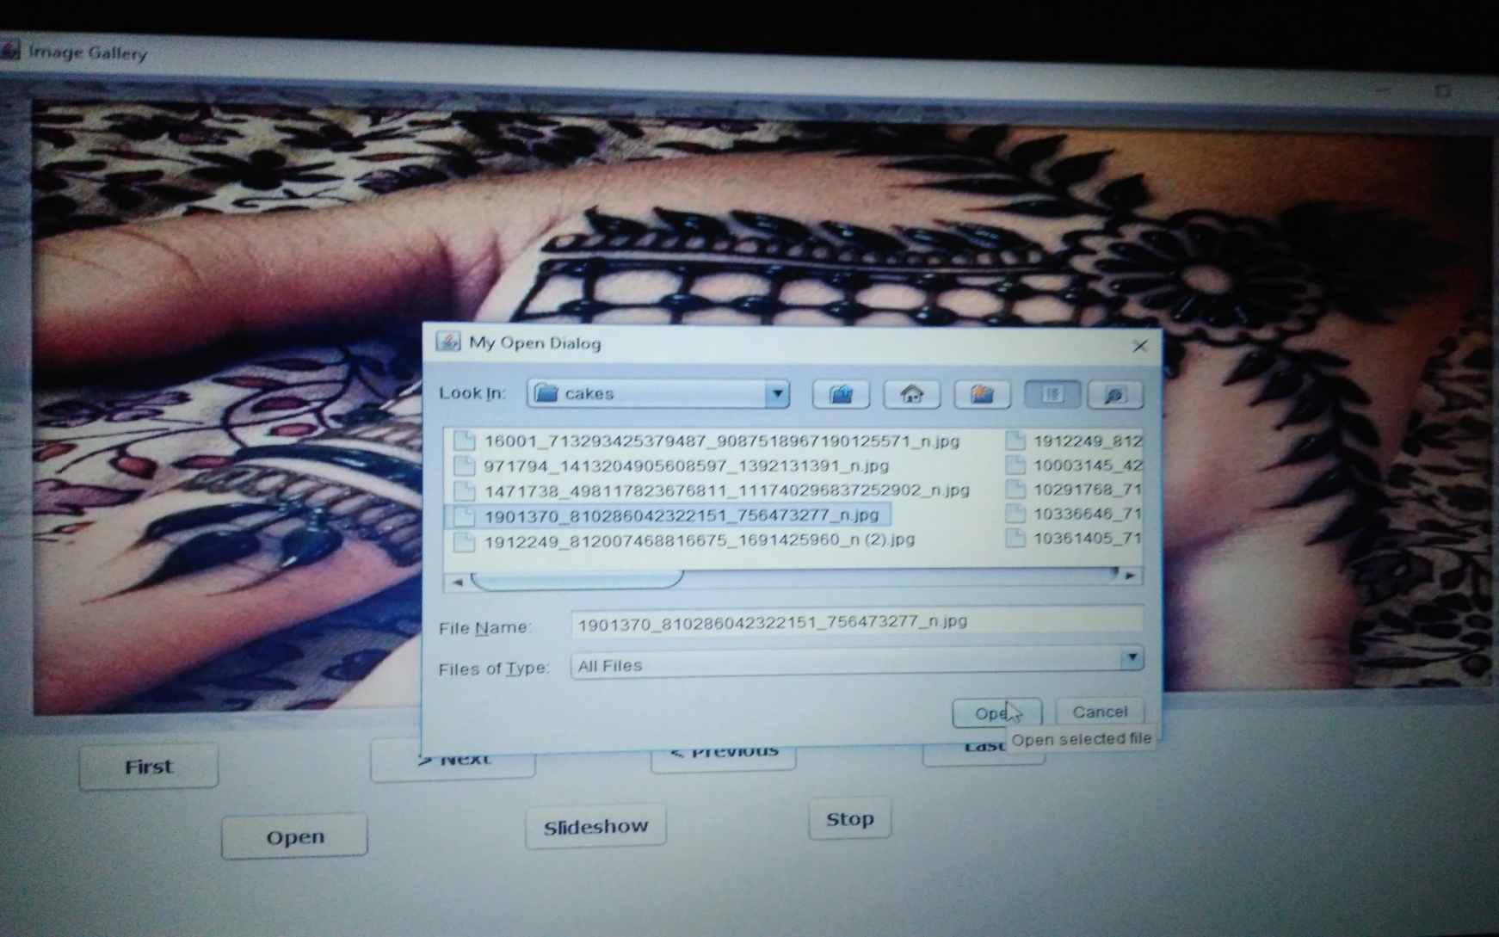
Output Screenshots

Slide 14
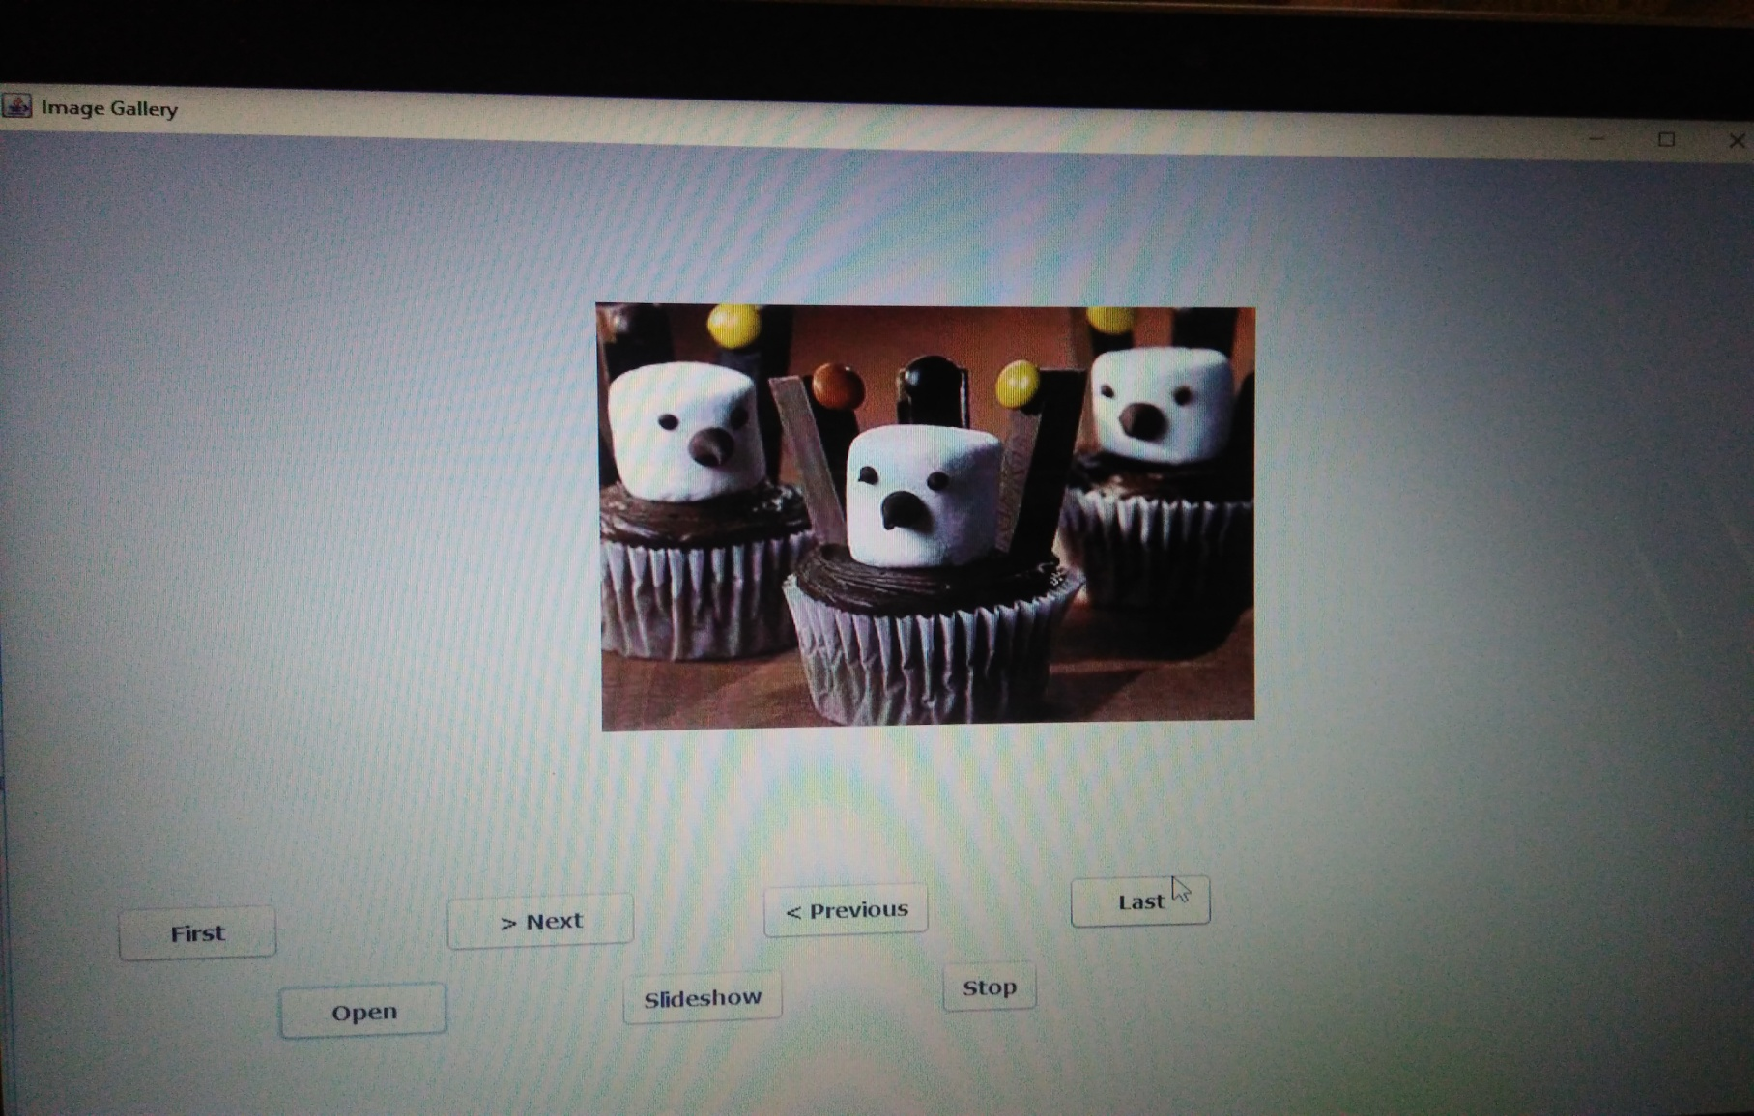
Output Screenshots

Slide 15
THANK YOU

